Slide 1
Key Concepts II - Replication

Slide 2
Dmitri Zagidulin dzagidulin@basho.com
Notes:
-- introduce yourself and basho

Slide 3
Key Concepts II Replication

Slide 5
Consistent Hashing
Notes:
-- take the bucket and the key
-- put them through a cryptographic hash
-- SHA function
-- quickly converts that to a new value
-- that value is between 0 and 2^160

Slide 6
The Ring
Notes:
-- 0 to 2^160 in a circle makes The Ring

Slide 7
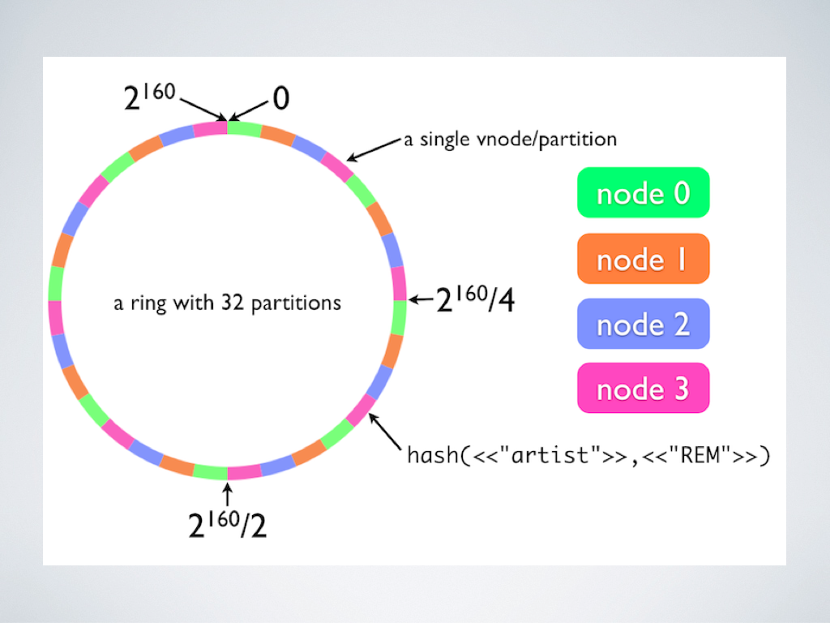
Notes:
-- just point out the values
-- 0 to 2^160
-- SHA hash of “artist” and “REM” lands there on the ring

Slide 8
Partition
Notes:
-- logical division of the ring
-- storage units on disk
-- ring_creation_size establishes the # of parttitions
-- don’t confuse with a network partition

Slide 9
Notes:
-- 32 partitions

Slide 10
VNode
Notes:
-- Erlang process that handles a partition
-- responsible for the Riak Objects that fall in this chunk of the ring
-- in a failure scenario, may be more than one vnode per partition

Slide 11
Notes:
-- a single vnode per partition
-- primary responsibility for that chunk of the ring

Slide 12
Nodes have VNodes
Notes:
-- remind that node usually corresponds to physical server
-- Node is instance of Riak
-- Vnode is just responsibility for chunk of Ring
-- therefore, Nodes have many VNodes

Slide 13
Notes:
-- Node 0 is responsible for all of the green data
-- each green chunk is one Vnode on Node 0

Slide 14
Replication [N Value]
Notes:
-- when data is written to Riak, multiple copies are saved
-- this is a key component of the redundancy and fault tolerance
-- default N Value is 3

Slide 15
Notes:
-- this Object falls on the magenta partition
-- magenta is Node 3
-- since N Value is 3, same data is also copied to Node 0 and Node 1

Slide 16
Quorum
Notes:
-- number of Nodes required to respond to an operation request [read/write/or delete]

Slide 17
Handoff *) Ownership *) Hinted
Notes:
-- handoff is a transfer of responsibility for a partition from one node to another
-- data is physically moved from one server [node] to anothr
-- two types

Slide 18
Ownership Handoff
Notes:
-- administrative event
-- membership in the cluster is changed by adding or removing a node
-- the data is moved, then the ownership is switched

Slide 19
Hinted Handoff
Notes:
-- failure event
-- ex: node becomes unresponsive
-- responsibility for a partition is reassigned to a fallback VNode until the Node becomes responsive again

Slide 21
Quorum
Notes:
-- number of Nodes required to respond to an operation request [read/write/or delete]

Slide 22
Quorum Values *) R *) W *) DW *) PR *) PW
Notes:
-- operation values that determine whether or not the request is successful

Slide 23
R
Notes:
-- read quorum
-- number of responses needed to be successful
-- options: one, all, quorum [N/2 + 1], arbitrary

Slide 24
W
Notes:
-- write quorum
-- number of responses needed to be successful
-- options: one, all, quorum [N/2 + 1], arbitrary

Slide 25
DW
Notes:
-- durable write
-- success when confirmed written to disk by storage backend, not the VNode

Slide 26
PR / PW
Notes:
-- primary read and primary write
-- number of responses required from primaries
-- is less permissive if in a failure state (relying on secondary fallback nodes)

Slide 27
Read Repair
Notes:
-- 3 versions of the value are fetched, and one doesn’t match
-- the latest Vclock is returned
-- background task added to update the one that doesn’t match
-- in this way, data that matters, that is actually accessed, is repaired over time

Slide 28
Siblings
Notes:
-- when faced with two values, default is last-write wins [according to v-clock]
-- or allow siblings
-- siblings will store both values
-- exercise for the application layer to resolve siblings

Slide 30
Notes:
-- review The Ring

Slide 31
Notes:
-- review replication

Slide 32
Handoff *) Ownership *) Hinted
Notes:
-- handoff is a transfer of responsibility for a partition from one node to another
-- data is physically moved from one server [node] to anothr
-- two types

Slide 33
Quorum Values *) R *) W *) DW *) PR *) PW
Notes:
-- operation values that determine whether or not the request is successful

Slide 34
Read Repair
Notes:
-- recovery and fault tolerance

Slide 35
Siblings
Notes:
-- conflict resolution policy

Slide 36
Key Concepts II Replication

Slide 37
Dmitri Zagidulin dzagidulin@basho.com
Notes:
-- introduce yourself and basho

